Slide 1
Managing Processes
Team or presenters name
Date: 26/05/2020
Location: DUB

Slide 2




Virtual Housekeeping
Use
Headsets
Go on
Mute
Participate Actively
Minimize Distractions
Notes:
***Please ensure you have your headset plugged in so we can avoid echoing and maintain audio quality
***Throughout the session, please keep your mic on mute to avoid background noise during the presentation portions.
***Please be aware you will be asked to participate and engage throughout the session. We ask that you are fully active in the chat box, and are also ready to be called on and unmute if needed. We’ll also have you click on some links to view videos, participate in polls and at some point during the session, we’ll be sending you to specific break out rooms depending on which service you’ll be shadowing.
***Lastly, we ask that you’re fully present. Keeping engaged is even more difficult in a virtual setting, so make sure you turn off notifications, maybe set an out of office in your email. Minimize distractions

Slide 3
Course objectives
What is a process
Process details
States and signals
Monitoring

Slide 4
What is a Process?
Instance of a program currently being executed
Process attributes:
Process ID (PID)
Parent Process ID (PPID)
Nice number
TTY
RUID and EUID (Real and effective user id)
SELinux context
Init process PID = 1
Notes:
(10 min)
A process is an instance of a program running:
-- The process use the CPU to run its instructions and memory to hold the process instructions and its data.
Linux is a Multi-user and multi-tasking SO, allowing several users running several processes at the same time. Multitasking is the method that allows the SO to share the CPU between all processes, but each CPU runs a single processes at a time. The kernel scheduler is controlling the access to CPU, assigning CPU time to the processes.
Each process has a identifier, Process ID (PID). Init process has pid = 1, it’s the first process in the system, and it’s the parent of all processes
-- Explain the attributes looking at ps –aux output.
-- To Explain RUID and EUID we can run as a regular user the command passwd (which has SUID enabled) and then run ps axo stat,euid,ruid,tty,tpgid,sess,pgrp,ppid,pid,pcpu,comm this will show how euid correspond to the root user while ruid corresponds to the user running passwd.

Slide 5
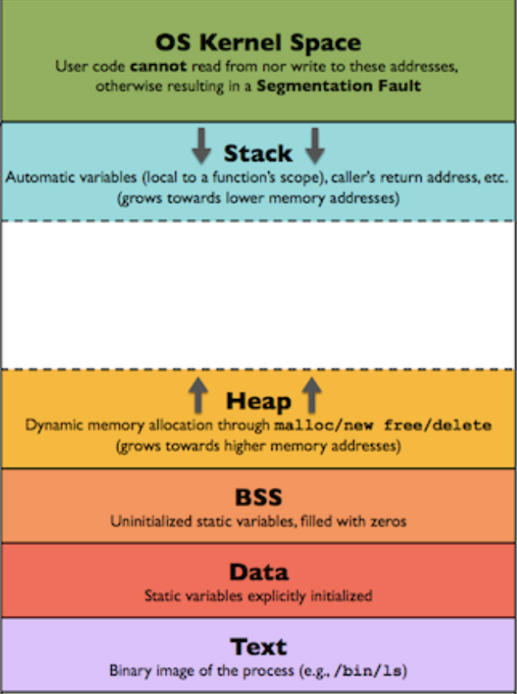
Process Memory Layout
Notes:
Kernel mantaines a process table in memory.
-- Process Memory Layout:
- Stack: where local variables are stored and function arguments, LIFO queue
- Memory mapping: mapping files to memory to avoid I/O, typically dynamic libraries) pmap
- Heap:
- BSS and data segments
- Text segment: the program instructions to be run by the CPU. The process can not modify this part or it will result in a segmentation fault

Slide 6
Types of Processes
User process: run by an user in user space
Daemon process: process running in the background, typically a service, example: httpd daemon.
Kernel processes: executed in kernel space. They have full access to kernel data structure.
Threads: there is no threads from kernel point of view. Threads are seen as processes -> Light weight process
Notes:
We can see the difference taking a look to the ps –aux output.

Slide 7
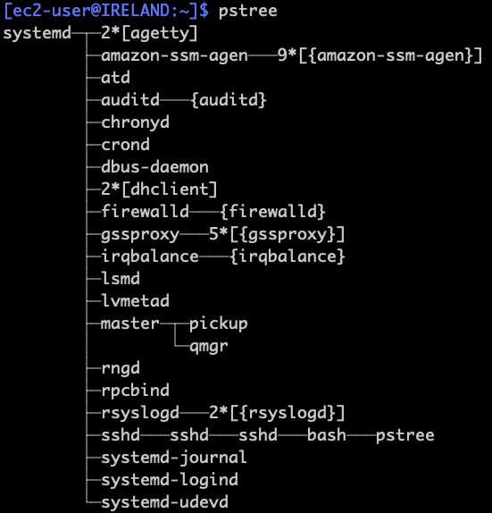
Process tree
Notes:
processes in linux are organized in a tree like structure
there is always a parent process, with the exception of PID 1 which is systemd/init
the first process is spawned by the kernel, where as subsequent ones are spawned by the respective parent process
tools like “pstree” will show this on the command line

Slide 8
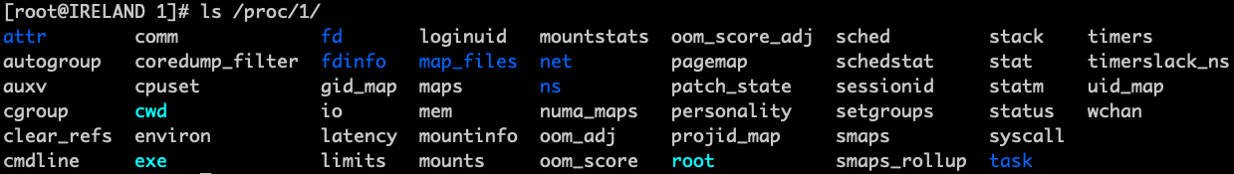
/proc/<PID>
Every process does have a folder under /proc/<PID>
gives in depth information
allows some configuration, like OOM score
information is read from here and displayed via top for example

Slide 9
Process lifecycle
The parent process clones itself via fork() ending in a new process with different PID
The forked process address space is replaced with the new process data: exec()
The process can be either killed or finish its execution by running the syscall exit()
parent also executes wait() syscall to get exit status from child process
Notes:
give brief explanation
also mention that instead of fork(), modern systems do use clone() which has a similar behaviour

Slide 10

Process states
Running / Runable (R): either running or in the run queue (runnable)
Sleep/Waiting (S,D)
Interruptible Sleep: waiting for a particular time slot (sleep) or waiting for an event (S)
Uninterruptible sleep: waits until a resource it is waiting for is available. Mostly used for device driver waiting for I/O. (D)
Stopped (T)
Zombie. Defunct (Z)
Process has run the exit() syscall, data structures are released however it’s still in the process table. The parent process releases the child process by running wait(). You can’t kill a zombie process as the process no longer exists.
Notes:
man top
(10 minutes)
Only one process can run at a time on a single CPU.
Processes are in running state until they have to wait for some resource, then the scheduler will assign CPU time to another queued processes.
Running: either running or waiting CPU time to be run
Waiting: Waiting for an event or resource
- Interruptible: can be interrupted by signals
- Uninterruptible: waiting directly on hardware conditions, can not be interrupted
Stopped: The process is stopped (typically because it has received a signal to indicate the process to stop ( CTRL + Z)
Zombie: Death process, it has finished its execution however it wasn’t cleaned up. This typically happen when the process runs exit() but the parent process didn’t call the wait() syscall. The process zombie process has finished, however it’s still in the process table.

Slide 11
Monitoring Processes
ps
top
uptime
pstree
pgrep
strace
/proc/PID/
Notes:
do live demo here of tools
Mention there is a different set of options for ps (UNIX options, BCD options, GNU long options, i.e. ps e is different to ps –e)
ps aux (a – all processes, not only owned by the user running ps, u – shows user name owning the process among other information, x – shows all processes, not only process tied to a tty, so it includes daemons as well)
- Explain the output of ps aux, top, uptime, etc showing real examples with our laptop.
USER PID %CPU %MEM VSZ RSS TTY STAT START TIME COMMAND
root 1 0.0 0.0 10648 652 ? Ss Jan08 2:31 init [2]
root 2 0.0 0.0 0 0 ? S Jan08 0:00 [kthreadd]
root 3 0.0 0.0 0 0 ? S Jan08 0:33 [ksoftirqd/0]
Explain output of top:
top - 18:46:59 up 184 days, 20:56, 1 user, load average: 0.09, 0.07, 0.09
Tasks: 129 total, 1 running, 128 sleeping, 0 stopped, 0 zombie
%Cpu(s): 1.2 us, 0.2 sy, 0.0 ni, 98.3 id, 0.2 wa, 0.0 hi, 0.1 si, 0.0 st
KiB Mem: 2026264 total, 2003380 used, 22884 free, 14548 buffers
KiB Swap: 1047548 total, 31404 used, 1016144 free, 1663712 cached
PID USER PR NI VIRT RES SHR S %CPU %MEM TIME+ COMMAND
4672 mic 20 0 344m 108m 3684 S 3.3 5.5 12119:57 deluged
2039 root 20 0 23776 1676 1188 R 0.3 0.1 0:00.05 top
12719 root 20 0 0 0 0 S 0.3 0.0 0:01.05 kworker/u8:0
1 root 20 0 10648 652 536 S 0.0 0.0 2:31.45 init

Slide 12
Signals
1) SIGHUP 2) SIGINT 3) SIGQUIT 4) SIGILL
5) SIGTRAP 6) SIGIOT 7) SIGBUS 8) SIGFPE
9) SIGKILL 10) SIGUSR1 11) SIGSEGV 12) SIGUSR2
13) SIGPIPE 14) SIGALRM 15) SIGTERM 17) SIGCHLD
18) SIGCONT 19) SIGSTOP 20) SIGTSTP 21) SIGTTIN
22) SIGTTOU 23) SIGURG 24) SIGXCPU 25) SIGXFSZ
26) SIGVTALRM 27) SIGPROF 28) SIGWINCH 29) SIGIO
30) SIGPWR
Kill: kill -9 3392, kill –SIGTERM 3392
Killall: killall -15 myprocess
pkill: pkill -9 myprocess
Notes:
-- Explain basic signals: SIGHUT, SIGINT (CTRL + C), SIGQUIT, SIGKILL, SIGUSR1/2 (user defined signals), SIGSTOP (CTRL + z), SIGTERM
-- Some signals require a routine in the program code to handle the signal
-- Explain commands showing real examples in the CLI.

Slide 13
Background and Foreground processes
Initiated and controlled through a terminal session
& - Run a process in background:
$ firefox &
[1]+ Done firefox
bg – send a stopped process to run in background
fg – bring a background process to foreground
jobs – list jobs running in background in the current tty. they can be references with %n
Notes:
Interactive processes are run by an user in a terminal sessions. They can run in the foreground occupying the terminal so we can’t run another processes or they can run in the background.
Do a demo in the command line:
Run a command:
mic@skynet:~$ stress --cpu 1 --timeout 100s
stress: info: [8947] dispatching hogs: 1 cpu, 0 io, 0 vm, 0 hdd
Process is running and the tty is busy. Press CTRL+Z (stop the process)
[1]+ Stopped stress --cpu 1 --timeout 100s
The status is “T”:
mic@skynet:~$ ps aux | grep stress
mic 8947 0.0 0.0 7304 428 pts/6 T 18:19 0:00 stress --cpu 1 --timeout 100s
mic 8948 20.8 0.0 7304 100 pts/6 T 18:19 0:02 stress --cpu 1 --timeout 100s
mic 8979 0.0 0.0 10464 916 pts/6 R+ 18:19 0:00 grep --color=auto stress
Send the process to background, it will continue running in the background and the tty is free.
mic@skynet:~$ bg
[1]+ stress --cpu 1 --timeout 100s &
State is running (R):
mic@skynet:~$ ps aux | grep stress
mic 8947 0.0 0.0 7304 428 pts/6 S 18:19 0:00 stress --cpu 1 --timeout 100s
mic 8948 32.1 0.0 7304 100 pts/6 R 18:19 0:06 stress --cpu 1 --timeout 100s
mic 8984 0.0 0.0 10468 920 pts/6 S+ 18:19 0:00 grep --color=auto stress
Bring the process to foreground, so we can interact with it
mic@skynet:~$ fg
stress --cpu 1 --timeout 100s
CTRL+C to terminate it.
Now we run the same command ending with &, the process runs directly in the background
mic@skynet:~$ stress --cpu 1 --timeout 100s &
[1] 9004
mic@skynet:~$ stress: info: [9004] dispatching hogs: 1 cpu, 0 io, 0 vm, 0 hdd
mic@skynet:~$ ps aux | grep stress
mic 9004 0.0 0.0 7304 428 pts/6 S 18:20 0:00 stress --cpu 1 --timeout 100s
mic 9005 99.5 0.0 7304 100 pts/6 R 18:20 0:07 stress --cpu 1 --timeout 100s
mic 9012 0.0 0.0 10468 920 pts/6 S+ 18:20 0:00 grep --color=auto stress
List jobs:
mic@skynet:~$ jobs
[1]+ Running stress --cpu 1 --timeout 100s &
Run another process:
mic@skynet:~$ stress --cpu 1 --timeout 100s &
[2] 9020
mic@skynet:~$ stress: info: [9020] dispatching hogs: 1 cpu, 0 io, 0 vm, 0 hdd
mic@skynet:~$ jobs
[1]- Running stress --cpu 1 --timeout 100s &
[2]+ Running stress --cpu 1 --timeout 100s &
Bring to foreground process number 2:
mic@skynet:~$ fg %2
stress --cpu 1 --timeout 100s

Slide 14
Process Priority
niceness [-20, 19], the bigger the niceness the lower the priority
nice
nice -19 stress --cpu 2 --timeout 100s (sets niceness to 19, lowest priority)
sudo nice --20 stress --cpu 2 --timeout 100s (sets niceness to -20, highest priority)
Renice
renice -2 27525 changes niceness to -2
renice 3 27525 changes niceness to 3
Only root user can set negative niceness
Notes:
Explain niceness concept, more nice means lower priority, letting other process going first (being nice)
Regular users can only lower the priority of their process (increasing the niceness, from 0 to 19)
Root user can also increase the priority, lowering the niceness until -20
Show how priority changes with top command
Notice difference between nice and renice in the way to specify the niceness (nice -20 sets a niceness of 20, renice -20 sets a niceness of -20)
Demo:
-- Run the command: nice -19 stress --cpu 2 --timeout 100s &
-- Run top: check the NI value is 19 instead 0. Check the the ni% CPU increases, as the CPU load is due to a niced process
-- Run sudo nice –20 stress –cpu 2 –timeout 100s, with top we can check now the nice value is -20, highest priority and it will increase the value of %us (user CPU). The value of ni% only applies for process with nice > 0

Slide 15
screen tool
creates a virtual terminal or screen
runs command in screen that you can attach/detach
screen –S copyjob
<execute copy job>
CTRL+a d (detach screen)
screnn –ls
screen –r
screen -X -S copyjob quit
handy for long running remote tasks

Slide 16
More Useful tools
netstat
Check to which processes belong each socket
lsof
List open files by a process
pmap
Check the memory mappings of a process
Notes:
netstat –nltp (list processes listening in TCP sockets)
lsof – lsof –p 1234 (list files opened by a process specifying the process ID)
pmap –p 1234 (list memory mappings for process with PID 1234)

Slide 17
You should now be familiar with…
what is a process
process details
states and signals
monitoring

Slide 18
Practical Exercise 1
get the PID,PPID and nice value of httpd
print the process tree
get memory information of the httpd process via /proc
list running processes
kill httpd
make httpd start again
check files opened by httpd
try the screen tool

Slide 19
Practical Exercise 2
ami-04c80debe77976e1e in eu-west-1
The customer does report that repeatedly every few minutes the system gets slow
Notes:
solution, scroll down for it
1 CPU gets stressed for 1 minute every five minutes via root crontab
use pstree to find out that process got spawned via cron

Slide 20
Insist on the highest standards
Please take 2 minutes to complete the survey to let us know what you liked about the training and what can be improved.
This will help us to continue creating helpful and relevant training content.
Link is in the invitation email.

